Slide 1
Determination of Thorium and Uranium in Detector material using Inductively Coupled Plasma Mass Spectrometry
Ying YUAN, Hao QIAO, Siguang WANG
School of Physics, Peking University

Slide 2
Outline
Brief introduction to Trace determination Lab
Experiments
Stainless Steel
Copper
MicroMegas
3D Printer Raw Material “Feinpolyamide PA 2200 for EOSINT P”
Summary

Slide 3
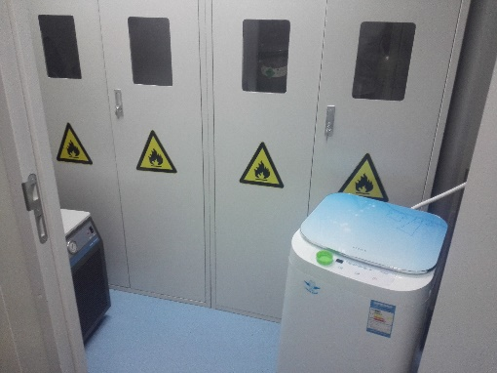
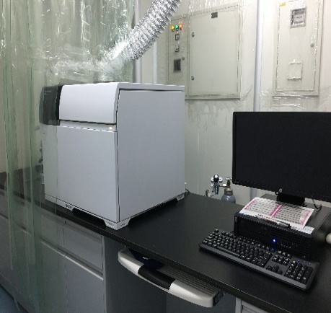
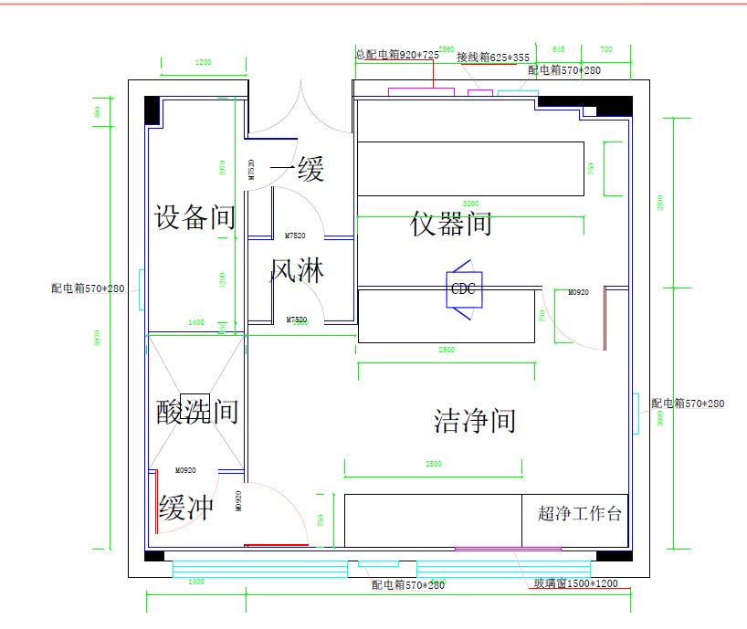
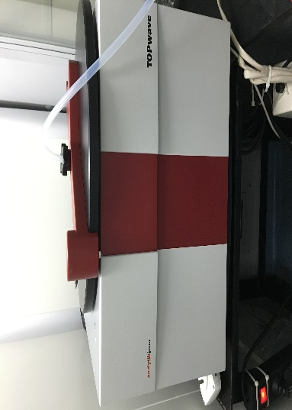
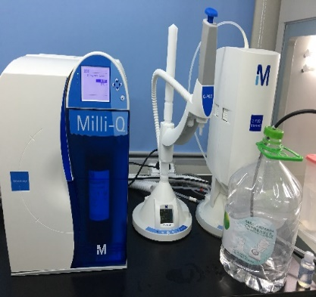
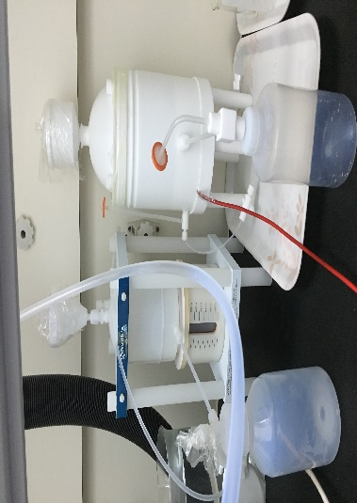
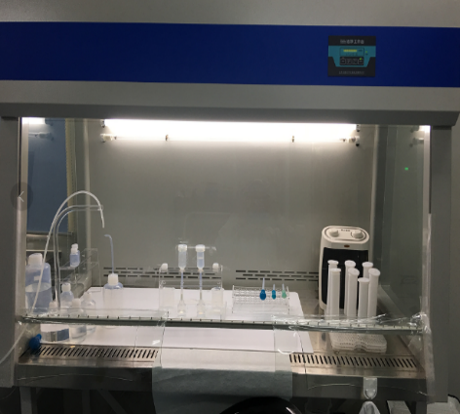
Brief introduction to Trace determination Lab

Slide 4
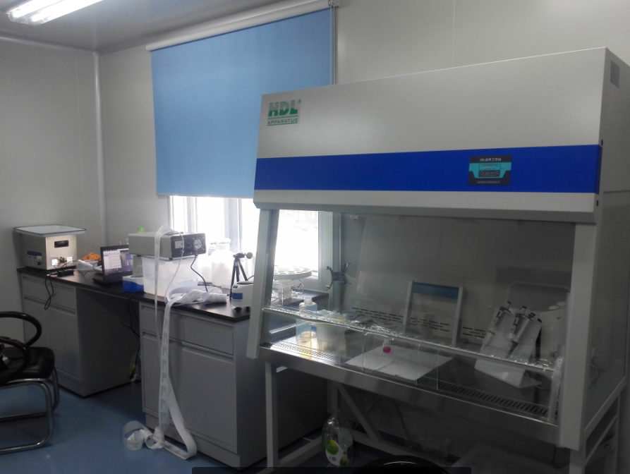
Cleanliness Measurement in Sample Preparation Room (Apr. 16,2016)

Slide 5
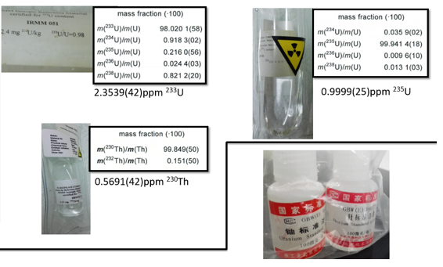
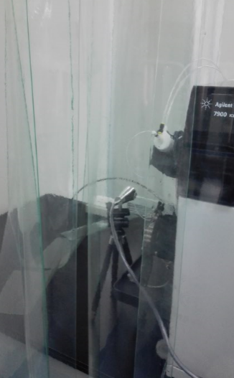
ICP-MS (Agilent 7900)
The injection port：
Class 10 laminar flowhoods
Isotope dilution analysis using radioactive tracers for U and Th
Notes:
载气将样品气溶胶载到等离子体的中心，进而样品发生干燥、去溶剂、解离、原子化和电离等过程
在管子的上部环绕着一水冷感应线圈，当高频发生器供电时，线圈轴线方向上产生强烈振荡的磁场。用高频火花等方法使中间流动的工作气体电离，产生的离子和电子再与感应线圈所产生的起伏磁场作用，这一相互作用使线圈内的离子和电子沿图市所示的封闭环路流动；它们对这一运动的阻力则导致欧姆加热作用。由于强大的电流产生的高温，使气体加热，从而形成火炬状的等离子体。

Slide 6
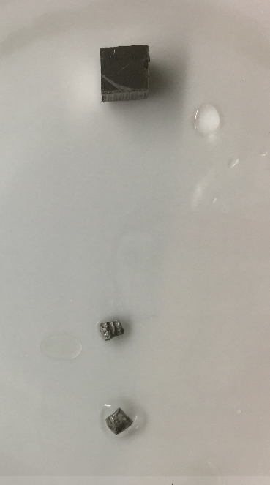
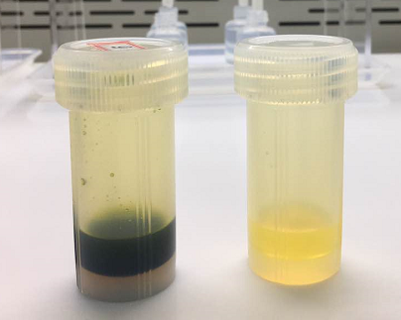
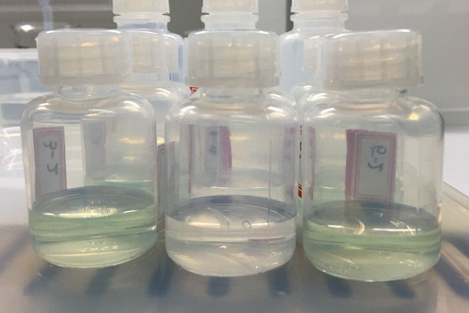
Experiments
Stainless Steel
Ca. 1 g
Preliminary results
Samples | Th-232 （pg/g)* | U-238 （pg/g)*
P4TC | 378 ±17 | 312 ± 24
P4TF | 606 ±129 | 1087 ±100
P4TN | 303±50 | 755±71
P4TM | 309±76 | 600±86
P4TO | 56±10 | 1026±100
P4TP | 872±58 | 764±87
Surface treatment
Dissolved in aqua regia(王水)
Diluted
Analyze
Detection Limits：
(Blank sample dilution:TDS<0.05%)
0.001 pg ²³²Th/g (0.05 μBq ²³²Th/kg)
0.019 pg ²³⁸U/g (0.24 μBq ²³⁸U/kg)
*Note：average±stdev
³⁹K in P4TO: 27、26 and 28(ng/g) for 3 samples

Slide 7
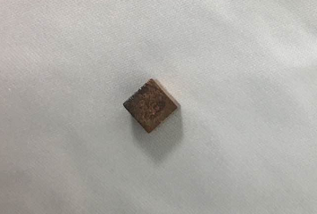
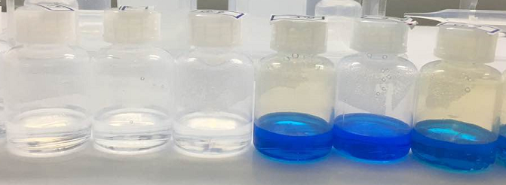
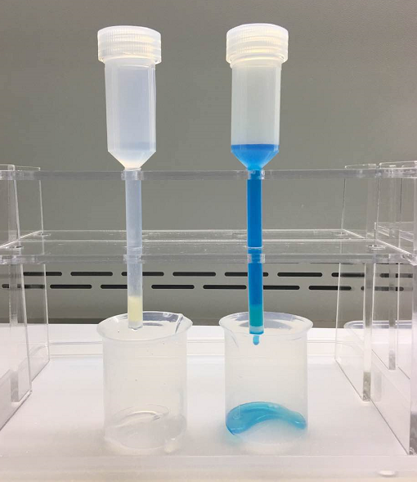
Experiments
Single Crystal Copper
Ca. 0.85 g
flow rate ：0.8 mL/min
Surface treatment
Dissolved in 8 M HNO₃ (spiked with ²³⁰Th and ²³⁵U)
Loaded on the Extraction Chromatography Column
Analyze
Preliminary results
Sample | ²³²Th pg/g | ²³⁸U pg/g
Cu 1 | 0.22±0.07 | 0.37±0.08
Cu 2 | 0.28 ±0.14 | 0.37±0.07
Cu 3 | 0.27±0.07 | 0.59±0.19
Cu 4 | 0.16±0.07 | 0.58±0.033
Cu 5 | 0.14±0.07 | 0.54±0.15
Detection Limits：
0.035 pg ²³²Th/g (0.14 μBq ²³²Th/kg)
0.073 pg ²³⁸U/g (0.90 μBq ²³⁸U/kg)

Slide 8
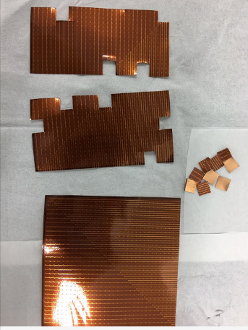
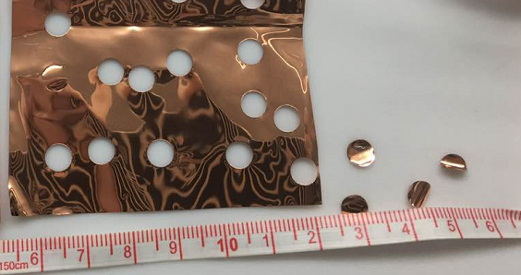
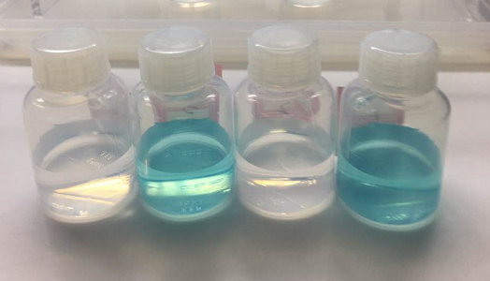
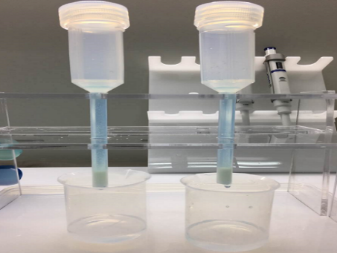
Experiments
MicroMegas
“GEM”
“BIPO”
Surface treatment
Microwave Digestion with concentrated HNO₃(spiked with ²³⁰Th and ²³⁵U)
Loaded on the Extraction Chromatography Column / Diluted
Analyze
Preliminary results
Sample | ²³²Th pg/g | ²³⁸U pg/g
GEM 1 | 36 ±16 | 273±7
GEM 2 | 34 ±13 | 308±42
GEM 3 | 118±25 | 292±34
BIPO 1 | 46 | 287
BIPO 2 | 43 | 266
Detection Limits：
0.24 pg ²³²Th/g (0.97 μBq ²³²Th/kg)
0.14 pg ²³⁸U/g (1.73 μBq ²³⁸U/kg)

Slide 9
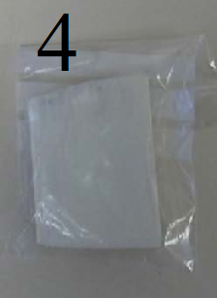
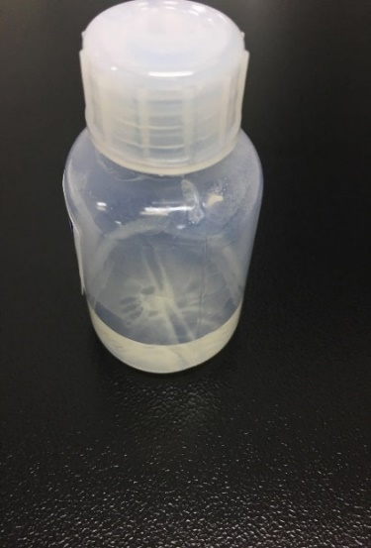
3D Printer Raw Material
3D Printer Raw Material “Feinpolyamide PA 2200 for EOSINT P”
Over simplified method summary:
Sample into microwave digestion instrument
Dissolve in nitric acids
Dilute and analyze
Preliminary results
Sample | Weight g | ²³²Th pg/g | ²³⁸U pg/g
1 | 0.09522 | 283 | 3586
2 | 0.09369 | 290 | 3386

Slide 10
Summary
A nice experimental environment for trace determination have been established. Cleanliness can be ISO Clean 10.
The analysis method for determining Th and U content in copper, stainless steel, micromegas was established.
The condition for 3D Printer Raw Material is being optimized.
Method Detection Limits (preliminary results)
Sample | MDLs ²³²Th pg/g | MDLs ²³⁸U pg/g
Copper | 0.035 | 0.073
Stainless Steel | 0.001 | 0.019
MicroMegas | 0.24 | 0.14

Slide 11
Thanks！

