Slide 1
PandaX I data taking summary
Jianglai Liu
June 1, 2014

Slide 2
High level activities
Jan 24, PMT on in LXe
Long campaign to set up the detector in stable running condition (field on with low PMT dark rate)
Feb 9 – Feb 27, cath 10 kV, grid 4.5 kV, ended with compressor trip
Mar1 – Apr 1, cath 10 kV, grid 4.2 kV, interleaved with many cryogenics trips, ended with TPC sparking and compressor trip (suspected due to unstable temperature)
Apr 5 – Apr 12, install KNF but gave up due to bad outgassing
Apr 12 – Apr 29, reached cath 10 kV, grid 5 kV, but ended with grid sparking (suspected due to unstable temperature)
May 1 – May 12, finally reached stable running condition (15 kV, 5 kV)
May 13 – May 18, uniformity calibration
May 19 – now stable running

Slide 3
Detailed history (a very long struggle!)
Jan 3-4, dry run conducted, all 184 channels read out
Jan 24, first time PMTs were turned on in LXe, very high dark rate
Feb 9, Mengjiao started improving the bottom PMT 200 kHz noise by installing the SS sleeve
Feb 12, first time cath 10 kV, grid 6 kV, observed S1/S2
Feb 13-15, holdoff trigger implemented, TPC leveling
Feb 16-21, major improvement to the DAQ by reading out FADC directly via fiber connection. Replacing PMT cables. Qdrive tripped. ZLE
Feb 22, Qdrive tripped
Feb 23, one HV group tripped – noise filter issue
Feb 24, monitor dark rate.
Feb 25, liquid level scan
Feb 26-, water cooling system installation
Feb 27, optimizing grid field, when up to 4.5 kV
Mar. 1-3 compressor off. E lifetime got bad. Water cooling installation completed

Slide 4
Mar 5, top3 decoupler channel broken causing instability of HV
Mar 7-8, Esum trigger threshold studies
Mar 9-10, lid closing
Mar 11, DM data trigger rate 3 Hz
Mar 12, getter & Qdrive off, 200 us trigger window
Mar 14, Q drive tripped again
Mar 15, Q drive tripped again: realized the need of isolation transformer, KNF preparation
Mar 16-17 Cs137, TPC sparking
Mar 18, lowered grid to 4 kV, still sparking
Mar 19, turned off the field, PMT dark rate calmed down
Mar 20, ramping the fielding up to 3.4 kV, dark rate still okay
Mar 21, field to 4.2 kV, dark rate still okay
Mar 22, power failure in the morning, recovered
Mar 23, ceremony
Mar 24, dark rate unstable, TPC sparking
Mar. 25, dropping grid HV to 3.2 kV, still high dark rate, compressor off, pump off

Slide 5
Mar. 26 sparking
Mar. 27, VME crate broken down, changed to the spare VME, water cooling fixed
Mar. 28, 10 kV/4.2 kV
Mar. 29, stable data
Mar. 30, Q drive tripped again
Mar. 31, data while recovering
April 1, grid tripped, DR unstable
April 2, compressor stops, high dark rate
April 3-4, recovering
April 5, KNF pump installed
April 6-7, setting up delayed start of compressor
April 10 DAQ nonstopper implemented
Apr 12-13, e-lifetime still low, switched to Qdrive
Apr 15, cath to 15 kV, DR increased a lot
Apr 16, e lifetime recovered
Apr 17, working on high energy anti-trigger
Apr 19, tried to put Qdrive onto the small UPS which tripped the small UPS

Slide 6
April 21 UPS problem fixed with OV turbo and Qdrive
Apr 22-23 ramping grid HV without cathode
Apr 23 power off, grid HV to 5.0 kV
Apr 24, cath 10 kV, grid HV 5.0 kV
Apr 25, planned power outage
Apr 26, lower threshold to 70 mV, noise trigger increased. Lowered grid HV
Apr 27 sparking started, lower field to zero
Apr 28 HV voltage crate lock up and tripped
Apr 29, planned power outage. Struggling with dark rate.
Apr 30, cathode off, ramp grid field
May 1, setting the temperature controller to avoid fluctuations. PMT HV accident with the death of 11806.
May 4, one decoupler channel could not hold HV, switched to a different one
May 5 cath and grid field scan
May 6 compressor down at mid night without notice
May 7 Esum threshold debugging (30 mV threshold with bottom Esum only)

Slide 7
May 8 reduced the gain
May 9, gamma and n calibration, 12 kV, 4.5 kV
May 10, calibration, 12 kV, 4.5 kV
May 11, 8 chan HV tripped, 15 kV, 4.5 kV, calibration, increase the grid field to 5 kV
May 12, cath 15 kV, grid 5 kV, DAQ unstable with many noise triggers
May 13-16, reduced gain ER calibration, on 16th realized that FADC has saturation at this gain setting
May 16-18, 1100 bottom PMT uniformity calibration
May 19 – now, regular gain, cath 15 kV, grid 5 kV, interleaved DM/ER/NR calibration
May 26 Maj trigger implemented for the DM runs

Slide 8
Major issues
Power outage, Q drive trips, compressor trips
PMT dark noises
Grid sparking
PMT death
200 kHz noises and trigger noises
FADC saturation
Remaining data quality issues
Data management

Slide 9
Major issues
Power outage, Q drive trips, compressor trips
PMT dark noises
Grid sparking
PMT death
200 kHz noises and trigger noises
FADC saturation
Remaining data quality issues
Data management

Slide 10
Power outage, Q drive trips, compressor trips
Power failure:
3 planned, 1 planned but not informed.
Planned power failure is not an issue
For unplanned power failure, we have backup power, but switching takes up to 6 s, which may screw up the cryogenics
Q drives
Tripped 7 times
May or may not affect LY and CY
Improved when using isolated transformer and UPS
Compressor
Tripped 4 times
Affect both LY and CY, usually takes 4 days to recover
Implemented auto-restart
3-phase UPS ready on-site to be installed

Slide 12
Digression: electronics

Slide 13
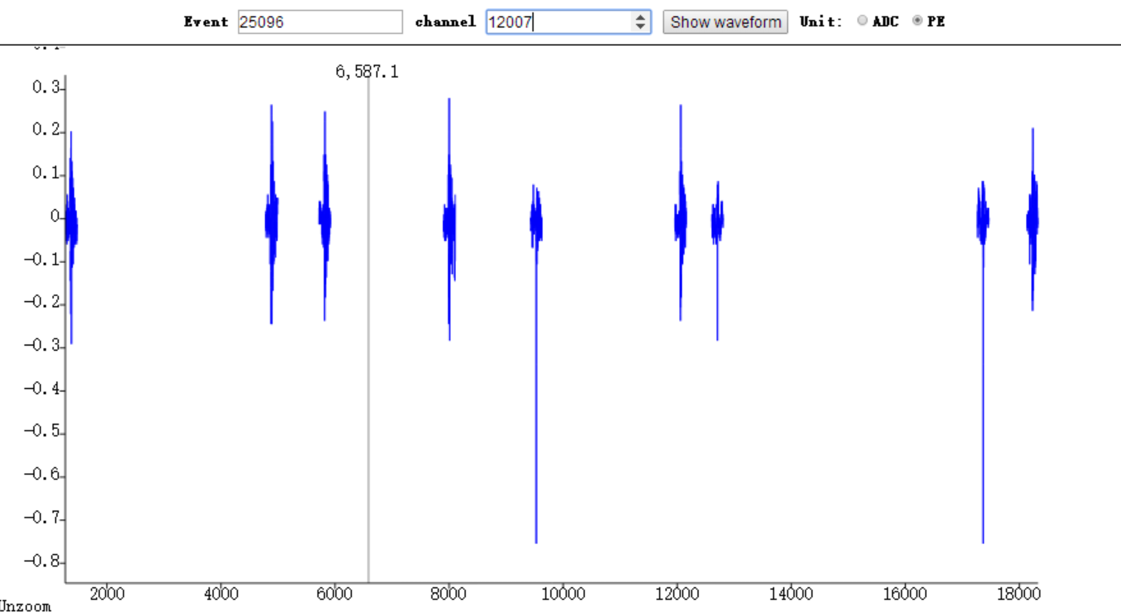
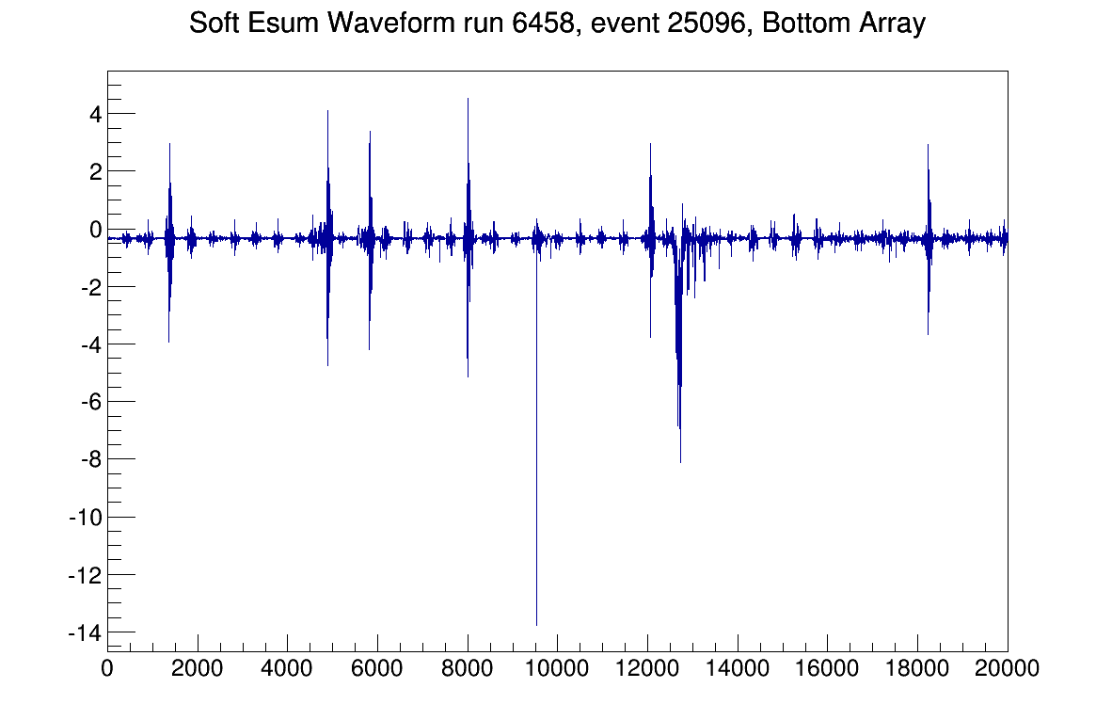
Digression: what do we measure in the data
Single channel
Software sum of all bottom channels
Baseline suppressed
“200kHz”
SPE Dark hits
S2
S1
“200 kHz”
SPE
Random pile-up of “dark noise” can be misidentified as S1=>high “dark rate” is an issue
200 kHz amplitude << SPE @ single channel, and has an oscillating shape
200 kHz noise correlated among channels

Slide 14
Major issues
Power outage, Q drive trips, compressor trips
PMT dark noises
Grid sparking
PMT death
200 kHz noises and trigger noises
FADC saturation
Remaining data quality issues
Data management

Slide 15
Jan 24
A typical bottom PMT, no field, MHz!
SPE hits (“dark noise”)
“200 kHz” noise
x10 ns

Slide 16
Handles?
Regular dark noise is 100 Hz/top PMT, and 2 kHz/bottom PMT
It can rise to very high (up to MHz) from time to time and persist
We do not understand the root cause yet, however we found some positive correlation with the following conditions:
When cryogenics is not stable
correlated with grid field, sometimes can be fixed by waiting or by cycling
Could be isolated to a single PMT, sometimes can also be cured by cycling the PMT HV
When ambient temperature is unstable
sometimes can also be cured by increaseing IV pressure, e.g. compressor off
When we “inject electrons” into the system, e.g. when accidentally putting too high a HV into a top PMT
At least the rate is low now

Slide 17
Major issues
Power outage, Q drive trips, compressor trips
PMT dark noises
Grid sparking
PMT death
200 kHz noises and trigger noises
FADC saturation
Remaining data quality issues
Data management

Slide 18
Hot spot
Very often concurrent with high dark rate.
May be cured by slowly cycling the grid HV (grid on first, then cathode)

Slide 19
Major issues
Power outage, Q drive trips, compressor trips
PMT dark noises
Grid sparking
PMT death
200 kHz noises and trigger noises
FADC saturation
Remaining data quality issues
Data management

Slide 20
PMT Death History in run5 (Shaoli)
Channel PMT ID Date Comment
10602 47 Start of run5 No output from DB25
11401 26 Start of run5 Bad PMT base
11405 30 Start of run5 Bad PMT base
11801 70 Start of run5 Bad PMT base
10500 7 3/20 Bad PMT base
11702 33 4/25 Bad PMT base
11804 95 5/01 accident, suspect feed-through broke down
11306 140 5/06 Bad PMT base
10607 79 5/23, run6411 Bad decoupler channel
11905: baseline is not stable!

Slide 21
Amplifier/Decoupler/filter death
Phillips x10 amplifiers has ~5 dead channels. Switched to spares => we may be better off not to use the amplifers
In two instance, we found bad HV noise filter boards which caused the HV to trip (replaced)
~15 decoupler channels broken down. Now using a 12-channel decoupler module (PandaX II)
Lesson learned: decoupler should be made to be robust and single-channel-replacable (Guodong’s talk)!

Slide 22
Major issues
Power outage, Q drive trips, compressor trips
PMT dark noises
Grid sparking
PMT death
200 kHz noises and trigger noises
FADC saturation
Remaining data quality issues
Data management

Slide 23
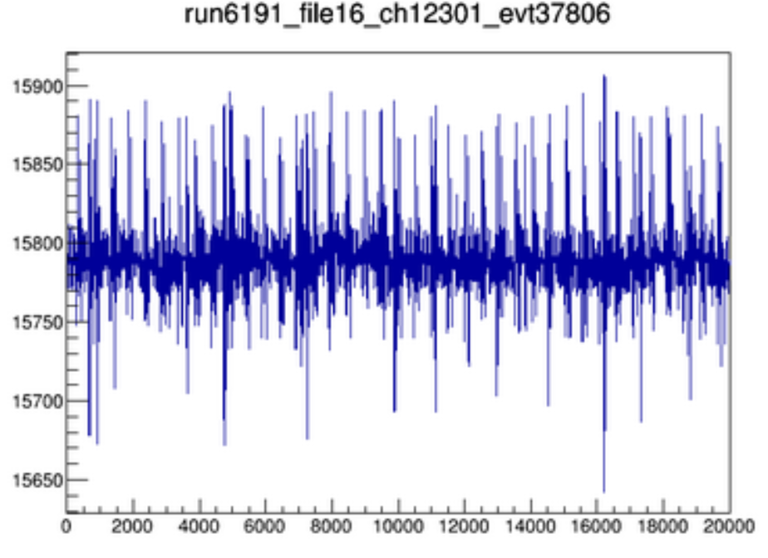
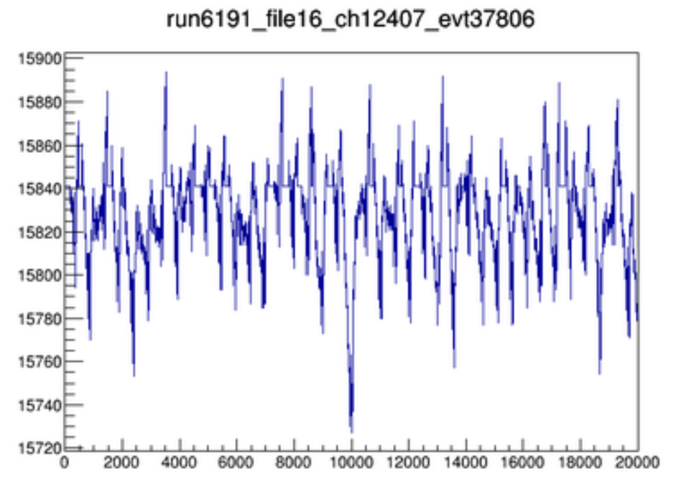
200 kHz noise affect Esum trigger
Integrator
ESum
Spec amp
disc
threshold
200 kHz noise, coherently summed
Pure noise in the spec amp charge output that generates fake trigger

Slide 24
Serious during low threshold runs (Shaoli)
Threshold set at ~200 PE, very close to the noise floor
Trigger rate fluctuated significantly in low threshold runs
Correlated with ambient temperature

Slide 25
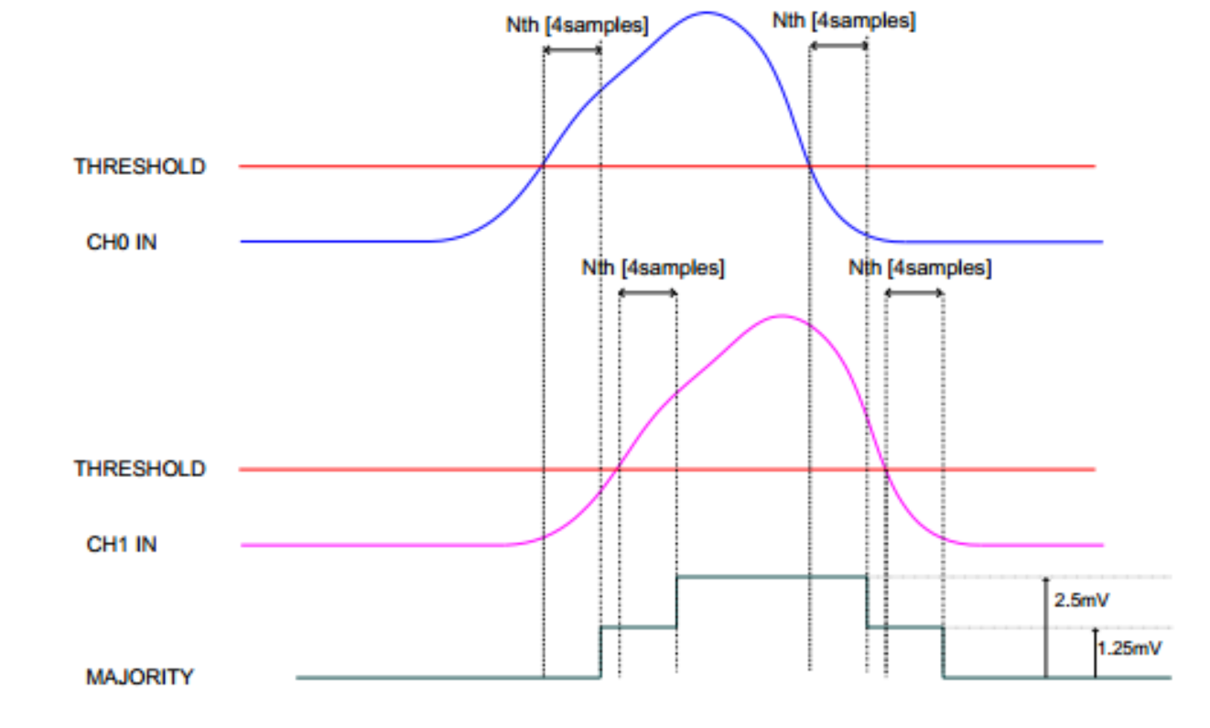
Improvement: “majority output” from V1724 (Ren Xiangxiang)
Each FADC channel as a time-over-threshold (ToT) signal of 125 mV amp (set threshold in FPGA to remove 200 kHz noise)
Each FADC board outputs the digital sum of the 8 ToT signal
The area of summed ToT encodes charge information!!!

Slide 26
Low charge S2
Consider multiple channel hits with SPEs separated in time
ch1
Ch2
Ch3
Majority output
Take this majority signal and integrate it through a spec amp with say 2 us shaping time to get the area then discriminate it!
1us
1us
time

Slide 27
Majority trigger status
Implemented in the DM runs in the last a few days
Performance stable, with an equivalent charge threshold of <100 PE

Slide 28
Major issues
Power outage, Q drive trips, compressor trips
PMT dark noises
Grid sparking
PMT death
200 kHz noises and trigger noises
FADC saturation
Remaining data quality issues
Data management

Slide 29
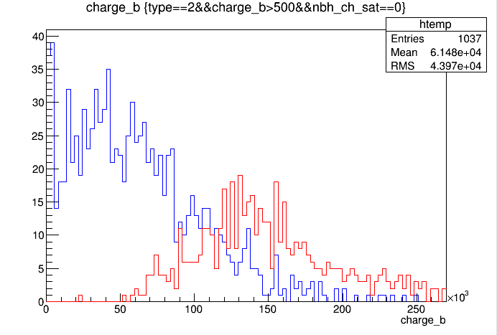
Cs137 S2, normal PMT gain
ADC is 14-bit (16384) for a dynamic range of 2.25 V
Had to lower HV by ~350 V on all bottom PMTs (so that we don’t saturate) to calibrate the uniformity of the charge yield!
Not a single b channel saturate
>= 1 b channel saturate
We may be better off not to use the amplifers
They amplifies the signals and noise!
Without them, we eliminate the saturation problem!

Slide 30
Major issues
Power outage, Q drive trips, compressor trips
PMT dark noises
Grid sparking
PMT death
200 kHz noises and trigger noises
FADC saturation
Remaining data quality issues
Data management

Slide 31
Remaining data quality issues (see Shaoli’s talk)
DAQ event misalignment and crash=>mostly fixed by using the auto-restart
Baseline of some PMTs shift from time to time
A few PMTs have unstable gains => use random hits to monitor the gain
Some channels are noisy from time to time, which seem to be correlated with cable quality => replace signal cables

Slide 32
Major issues
Power outage, Q drive trips, compressor trips
PMT dark noises
Grid sparking
PMT death
200 kHz noises and trigger noises
FADC saturation
Remaining data quality issues
Data management

Slide 33
Data management difficulties (Xun)
Data size
Dark matter run: Trigger rate ~ 3Hz, 1 data file /8.5min, 170GB/day
Calibration run: Trigger rate ~ 30Hz, 1 data file/1min, 1.3 TB/day
Average: 6 hour calibration + 16 hour dark matter, 480GB/day, 100 days → 45TB
Disk space
DAQ: 9TBx2 in use, old files need to be removed frequently.
SJTU cluster: 60+20 TB
USB drive: copy data back and store files permanently, 30x3TB.
Had number of disk emergencies => Xun and Si-ao set up file-tracker DB + automated scripts to handle the transfer
Limited network band-width => only copy data during DM runs
On-site computer is frequently lagging when processing data => buying an additional computing server

Slide 34
Summary of “golden” runs (5/19-5/30)
Mengjiao had a wiki page: http://pandax.physics.sjtu.edu.cn/foswiki/PandaX/Software/GoldenRuns
Run type | DAQ time (hr)
ER calibration (Co60) | 55
NR calibration (Cf252) | 8
DM | 120 (Esum), 73 (MAJ)

