Slide 1
²³²Th and ²³⁸U Concentrations measured by the ICP-MS in PKU
Ying YUAN Hao QIAO Siguang WANG
School of Physics, Peking University

Slide 2
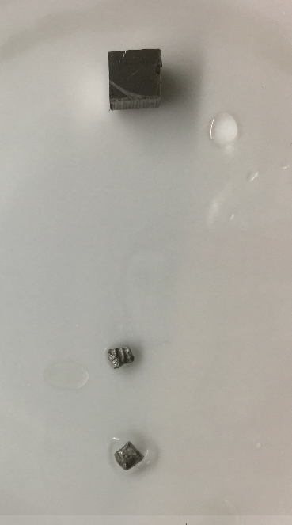
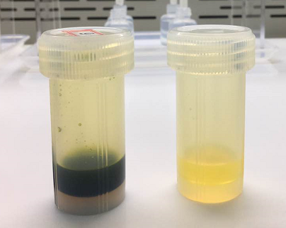
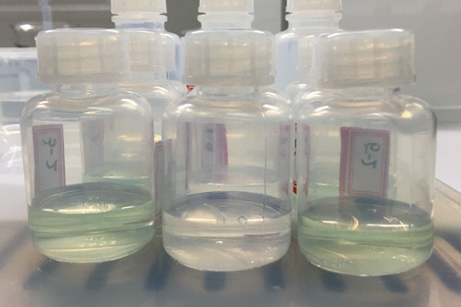
Stainless Steel
Surface treatment
Dissolved in aqua regia(王水）
Diluted
Analyze(Using standard addition method or dilution)
Samples | Th-232 （pg/g)* | U-238 （pg/g)*
P4TC | 378 ±17 | 312 ± 24
P4TF | 606 ±129 | 1087 ±100
P4TN | 303±50 | 755±71
P4TM | 309±76 | 600±86
P4TO | 56±10 | 1026±100
P4TP | 872±58 | 764±87
³⁹K of P4TO: 27、26 and 28(ng/g) for 3 samples
*Note：average±stdev

Slide 3
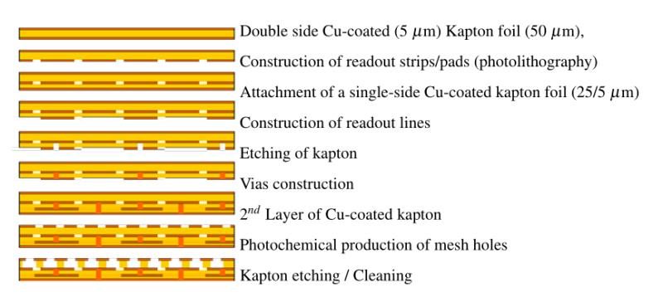
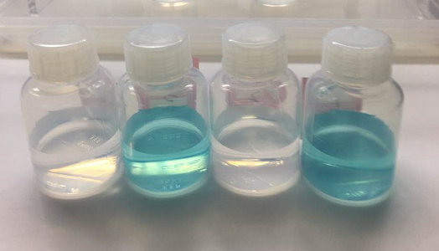
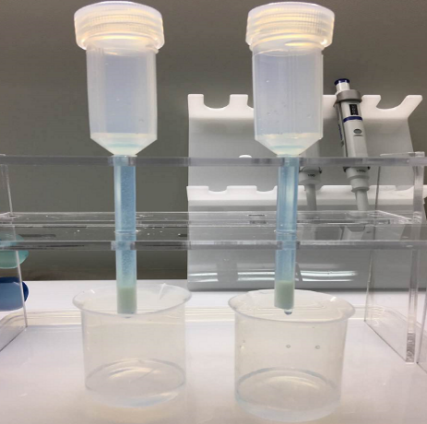
MicroMegas (GEM)
Ca. 0.088 g
Surface treatment
Microwave Digestion with concentrated HNO₃(spiked with ²³⁰Th and ²³⁵U)
Loaded on the Extraction Chromatography Column
Analyze
 | Preliminary
Sample | ²³²Th pg/g | ²³⁸U pg/g
mm 1 | 36 ±16 | 273±7
mm 2 | 34 ±13 | 308±42
mm 3 | 118±25 | 292±34
Detection Limits：
0.24 pg ²³²Th/g (0.97 μBq ²³²Th/kg)
0.14 pg ²³⁸U/g (1.73 μBq ²³⁸U/kg)

Slide 4
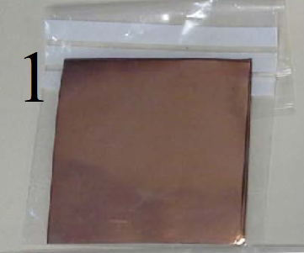
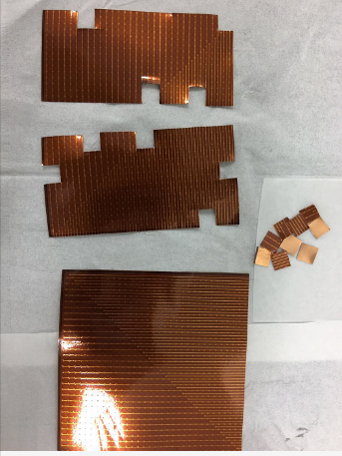
Micromegas “BIPO”
Sample | Weight g | ²³²Th pg/g | ²³⁸U pg/g
1 | 0.09796 | 46 | 287
2 | 0.10556 | 43 | 266
Over simplified method summary:
Sample into microwave digestion instrument
Dissolve in nitric acids
Dilute and analyze

Slide 5
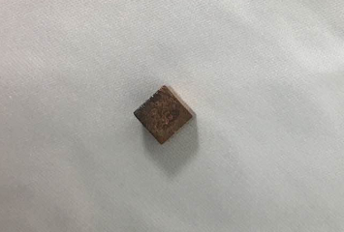
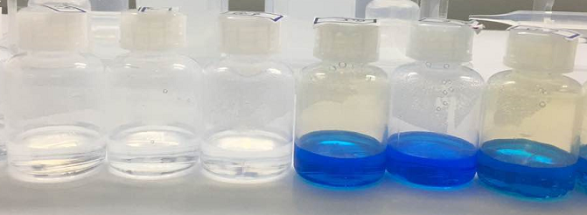
Copper(Single crystal copper)
Ca. 0.85 g
flow rate ：0.8 mL/min
Surface treatment
Dissolved in 8 M HNO₃ (spiked with ²³⁰Th and ²³⁵U)
Loaded on the Extraction Chromatography Column
Analyze
 | Preliminary
Sample | ²³²Th pg/g | ²³⁸U pg/g
Cu 1 | 0.22±0.07 | 0.37±0.08
Cu 2 | 0.28 ±0.14 | 0.37±0.07
Cu 3 | 0.27±0.07 | 0.59±0.19
Cu 4 | 0.16±0.07 | 0.576±0.033
Cu 5 | 0.14±0.07 | 0.54±0.15±
Detection Limits：
0.035 pg ²³²Th/g (0.14 μBq ²³²Th/kg)
0.073 pg ²³⁸U/g (0.90 μBq ²³⁸U/kg)

Slide 6
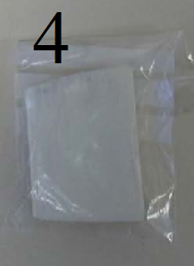
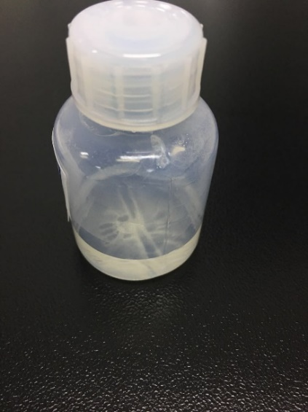
3D printer raw material “Feinpolyamide PA 2200 for EOSINT P”
Sample | Weight g | ²³²Th pg/g | ²³⁸U pg/g
1 | 0.09522 | 283 | 3586
2 | 0.09369 | 290 | 3386
Over simplified method summary:
Sample into microwave digestion instrument
Dissolve in nitric acids
Dilute and analyze

